Slide 1
Classnotes
A Discussion Forum for Students and Teachers
Henry Zakay & Norman Fong

Slide 2
Concept
A platform for students to engage together
Allows students to study and teach what they’re learning in class.
Brings together students of different levels and understanding to create a community of learning and growth.
Combines into an online collaboration project, an encyclopedia, and features questions and answers in a forum.

Slide 3
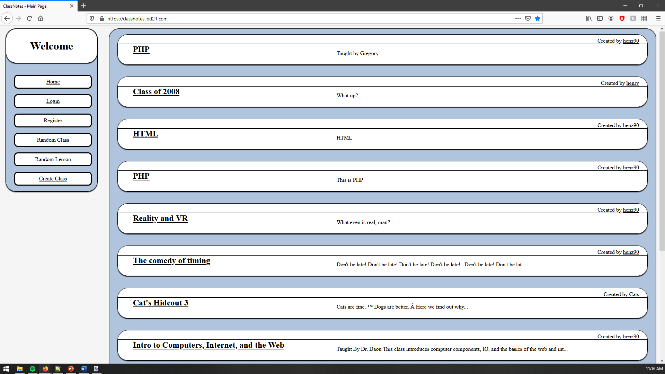

Slide 4
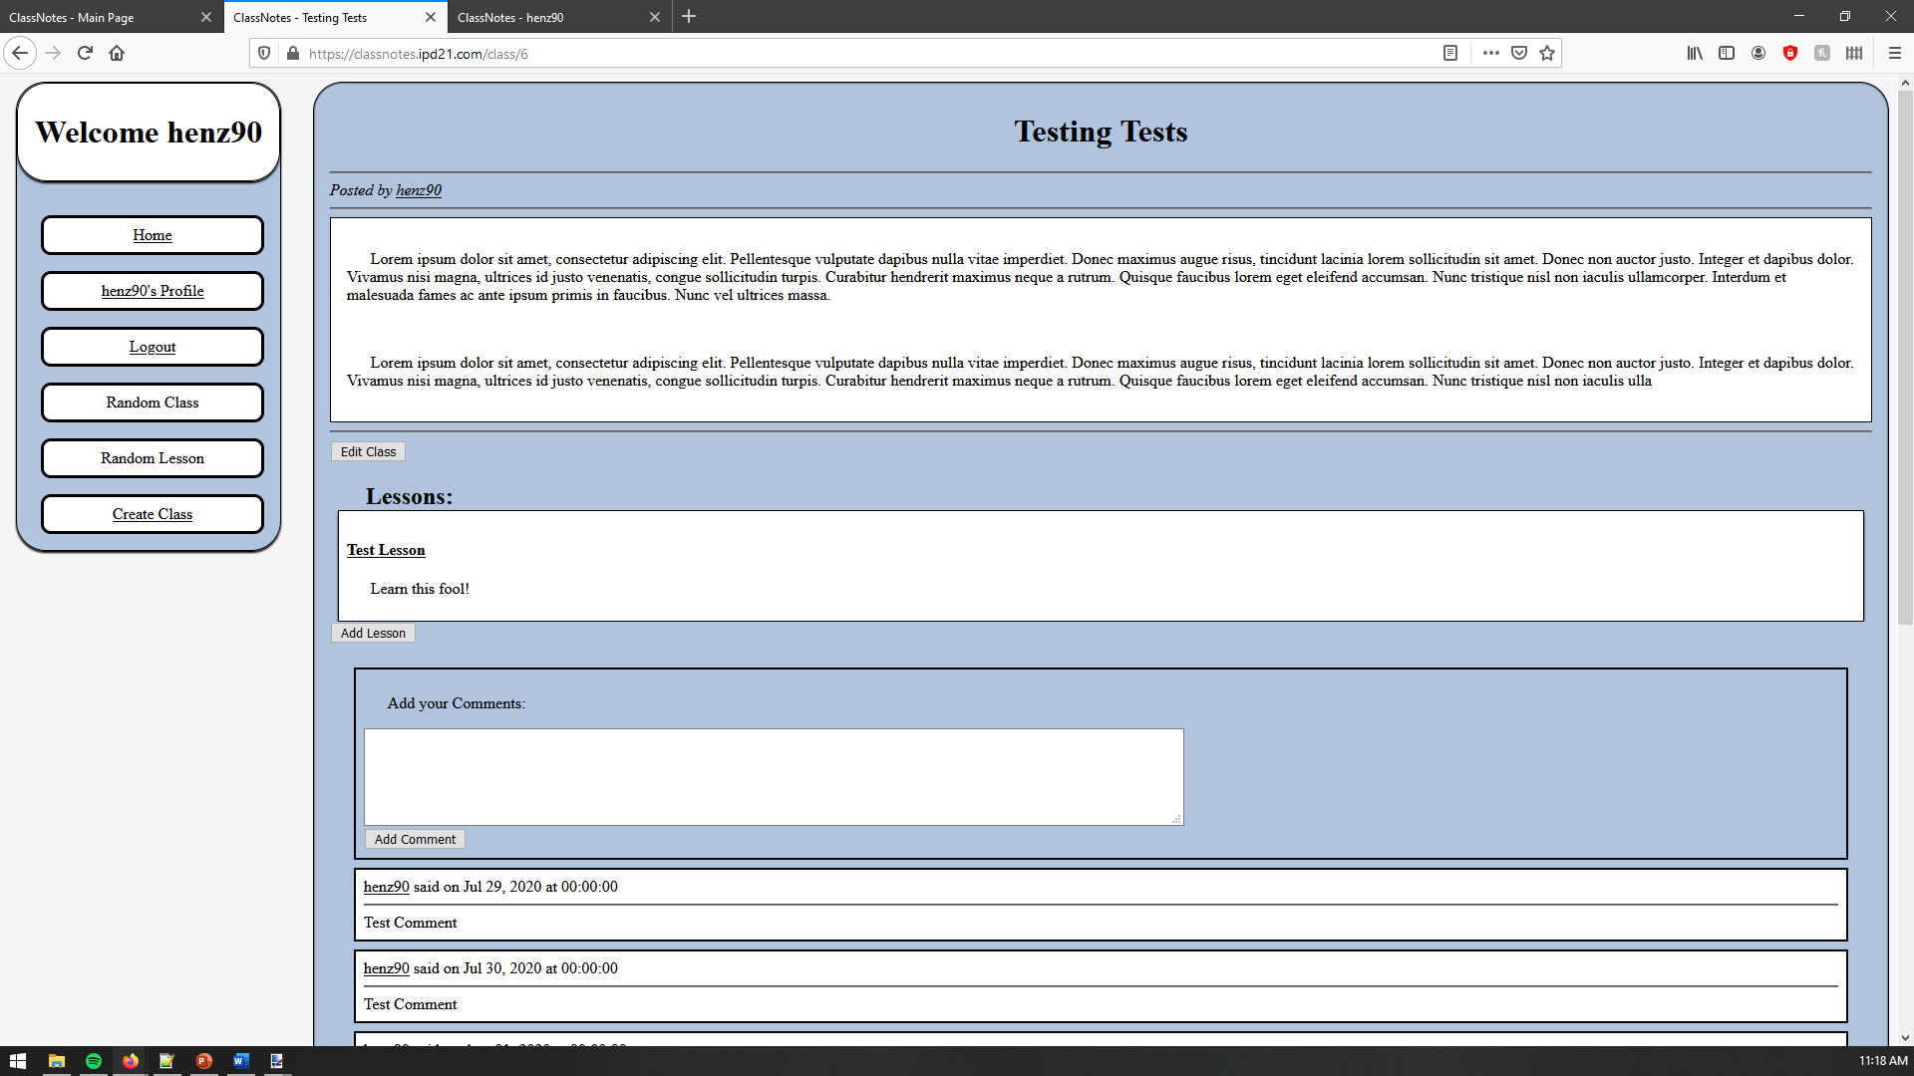

Slide 5
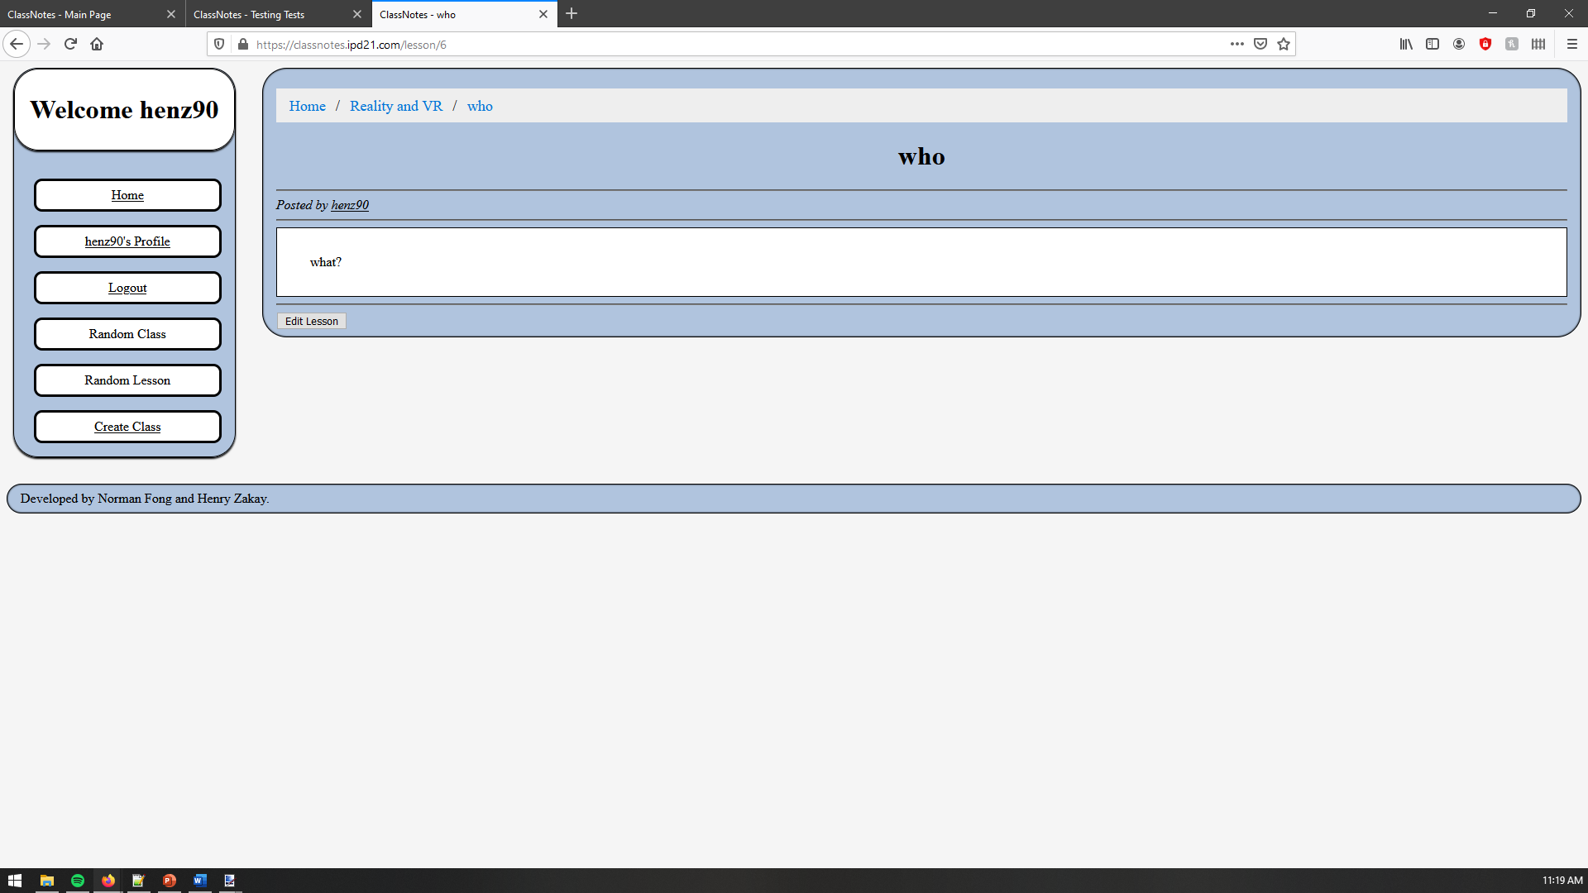

Slide 6
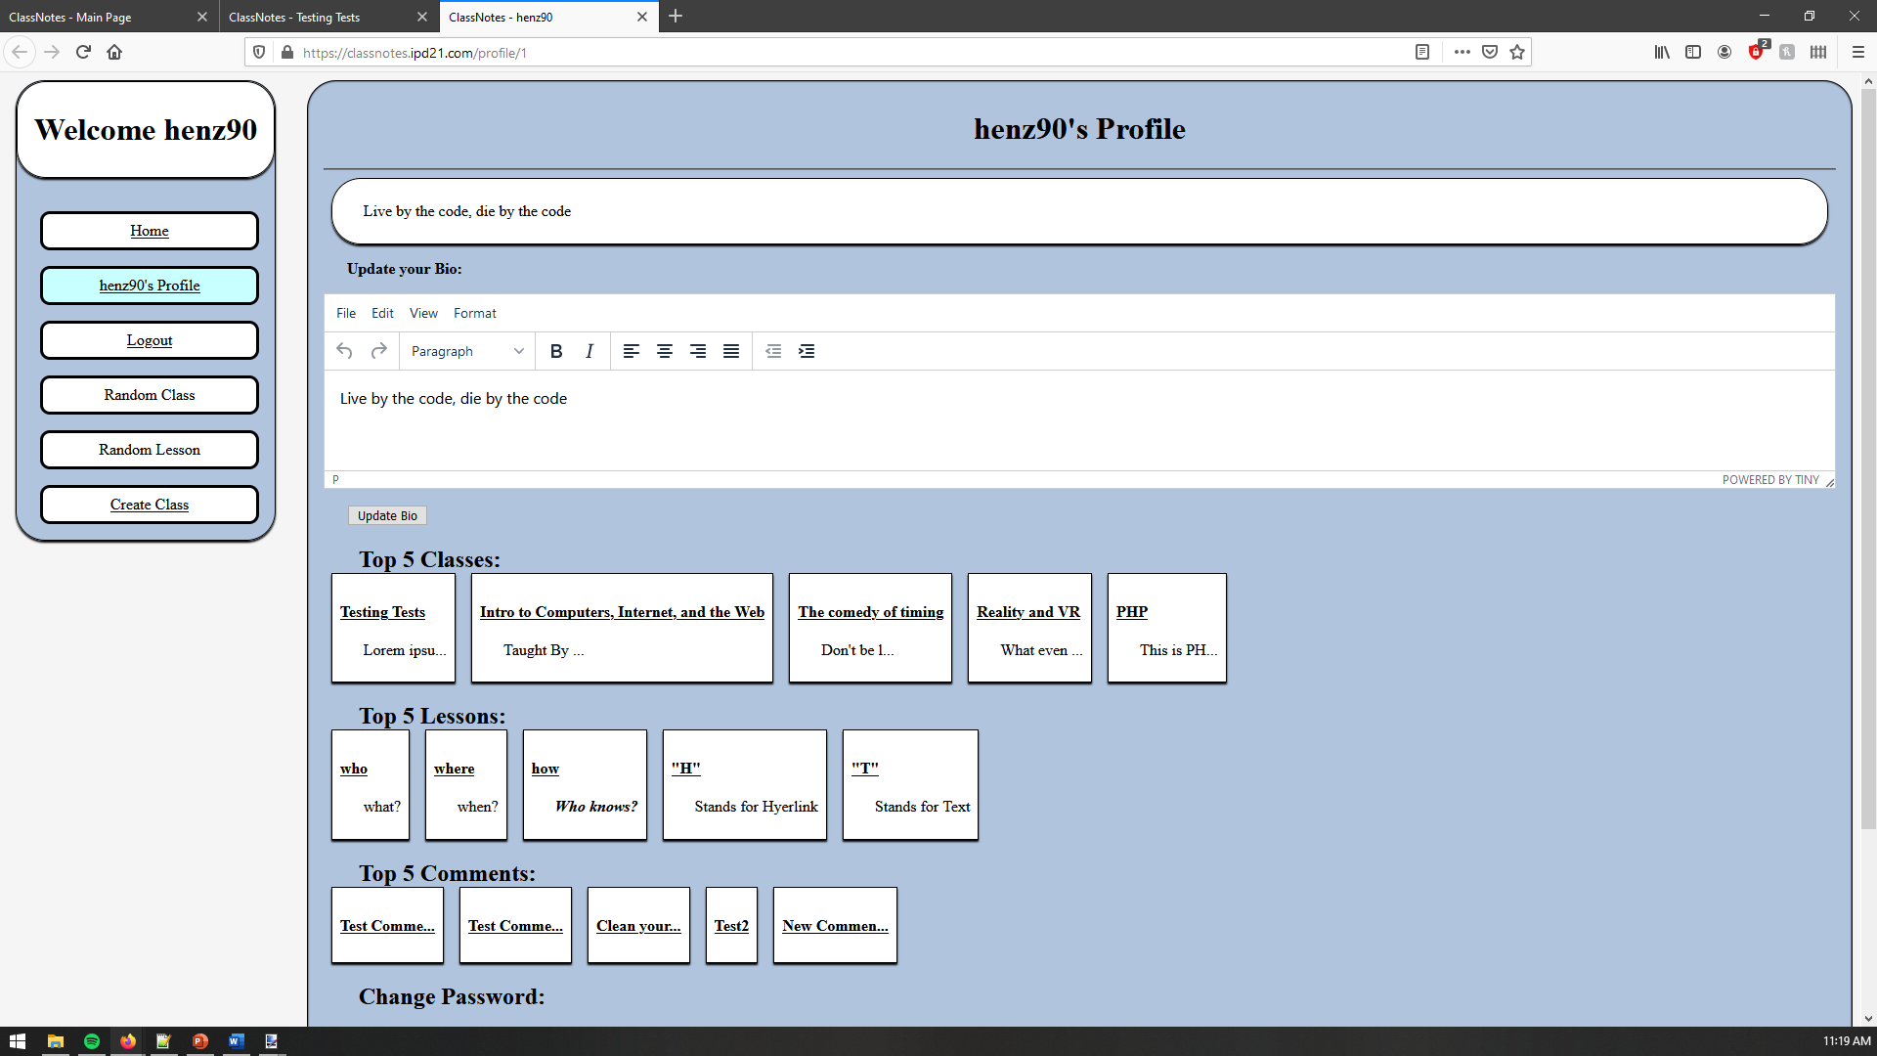

Slide 7
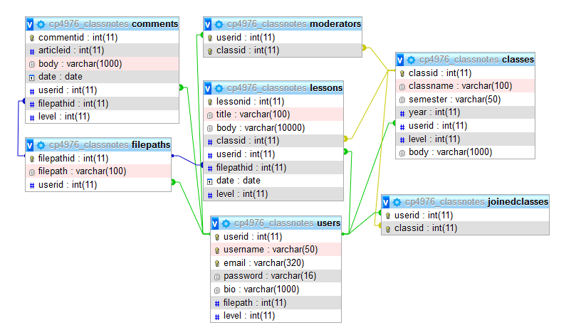
Data Structure

Slide 8
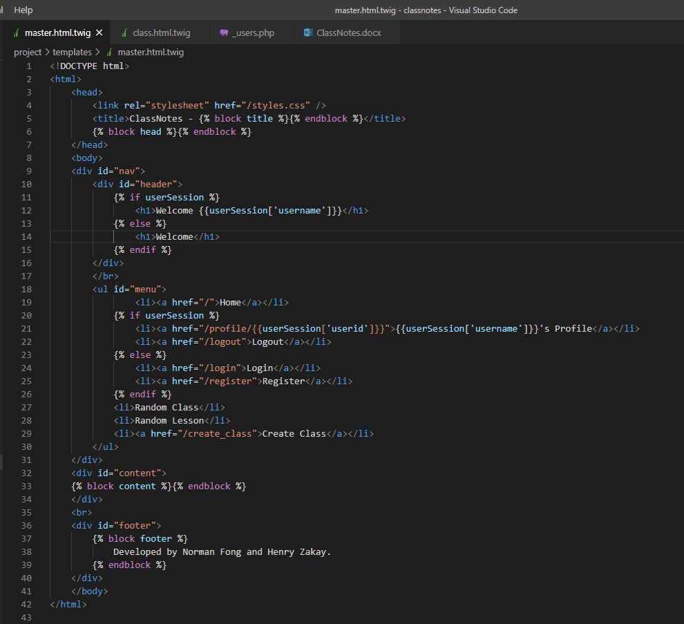
Challenges and Solutions: MASTER

Slide 9
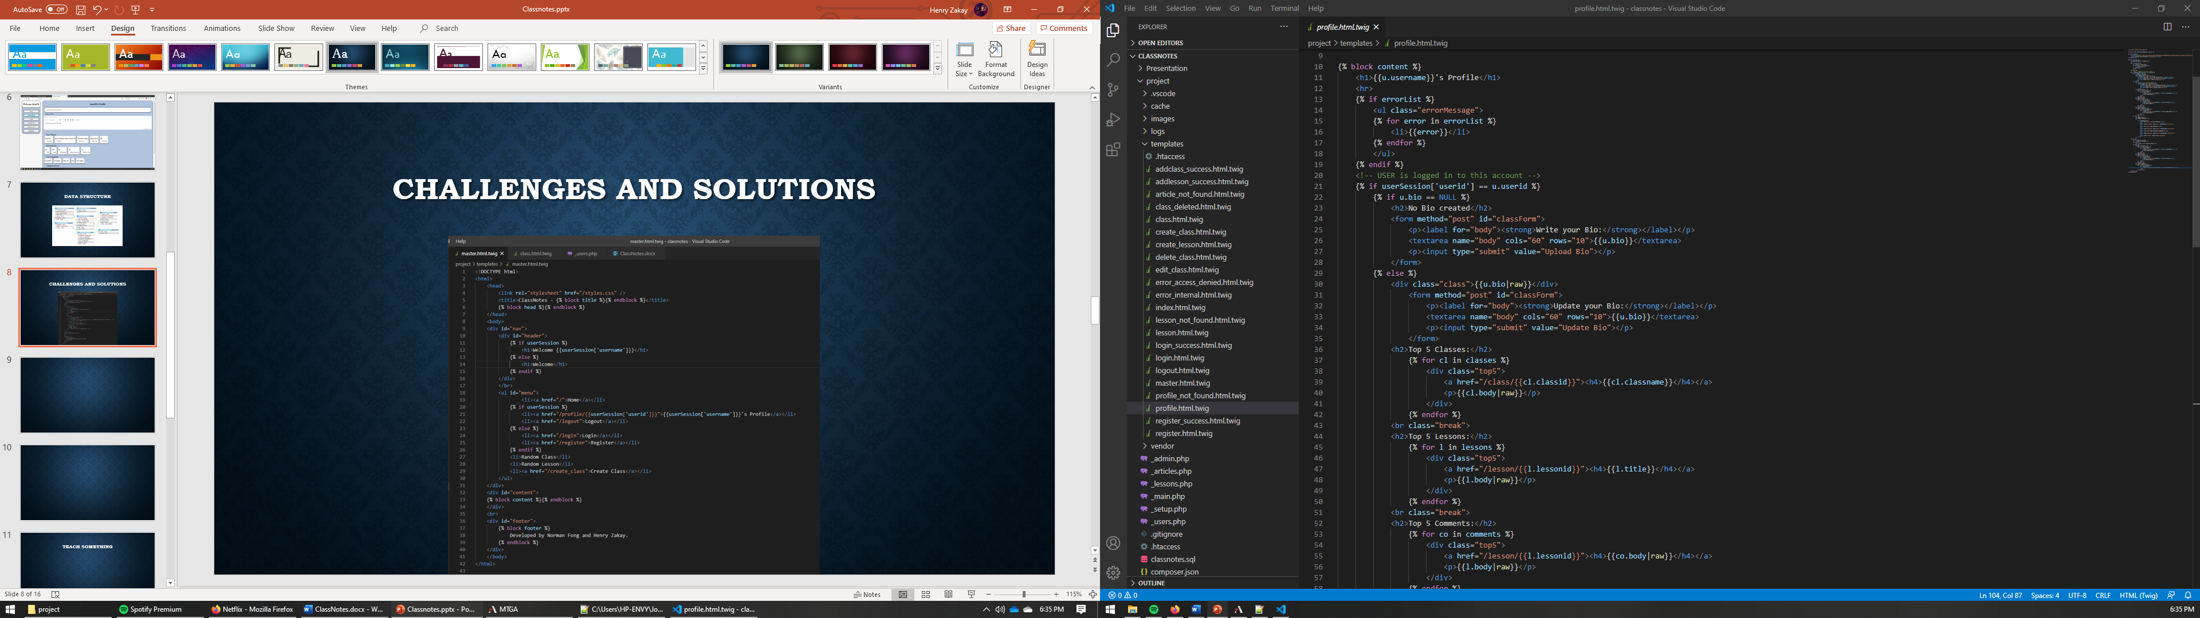
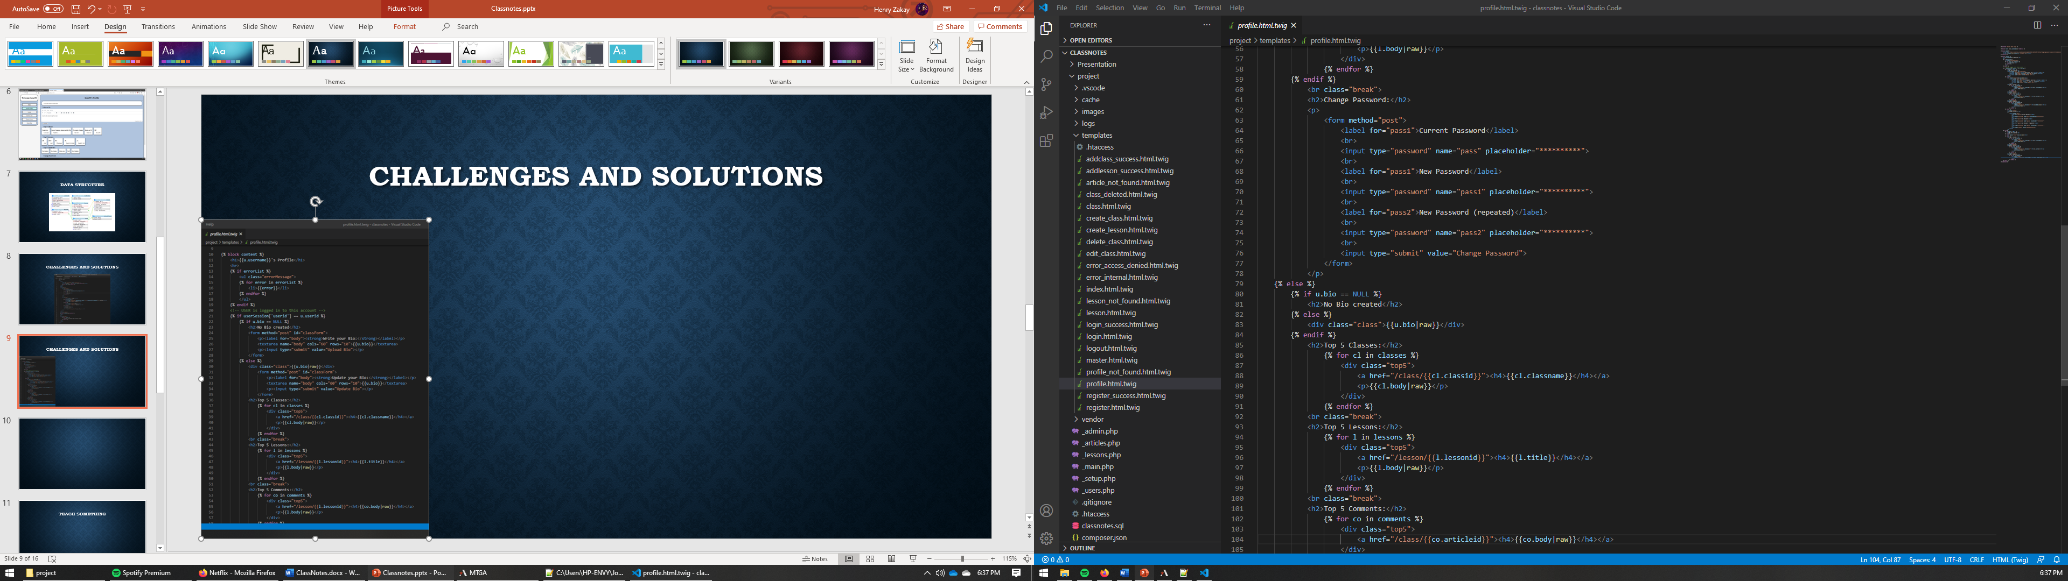
Challenges and Solutions: Profile

Slide 10
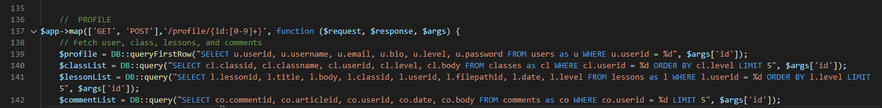
Teach Something: Limit 5

Slide 11
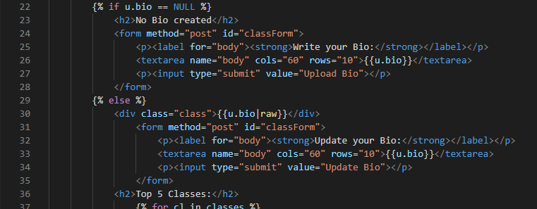
BIO|Raw

Slide 12
Future Development
Random Class / Random Lesson
Voting System
Beautification
Bug Fixes:
Create Class Redirect Issue
Login Redirect Issue
Profile Bio Update Issue
Password Encryption

Slide 13
Sum
Great way to practice and hone PHP skills
This project’s simplicity allowed for a wide array of solutions, picking the best for us wasn’t easy.
Given more time we could expand on this project and develop it further

